Slide 1
Docker Introduction
Hung.Tran

Slide 2
CONTENT
What is Docker?
Why is Docker?
What problems does Docker solve?
Docker Architechture
Docker Installation
Using Docker Client
What is Docker Container
How’s docker running on your computer

Slide 3
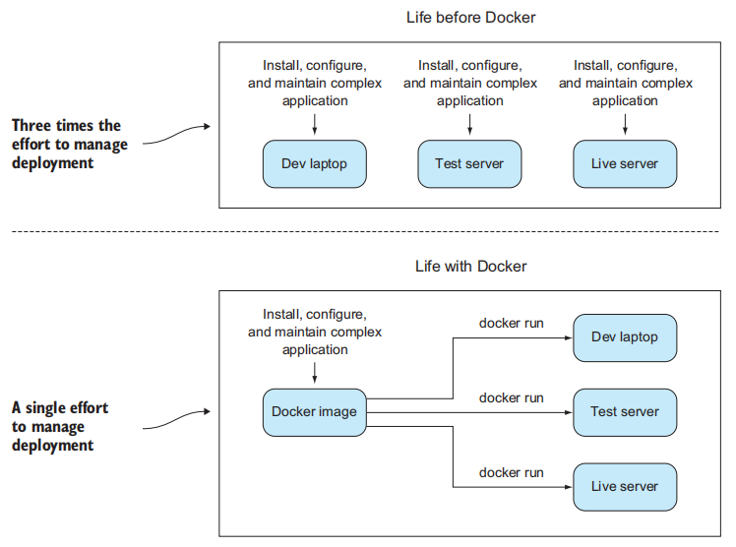
What is Docker?

Slide 4
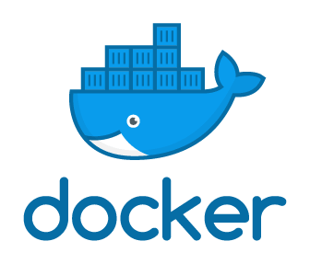
What is Docker?
Docker is an open source platform for building, deploying and managing containerized application
Docker enables you to seperate your applications from your infrastructure so you can deliver your software quickly
Notes:
- Writing a software in a docker-wrapped development environment will save your time configuring or sharing that invironment, because from the perspective of you software, every environment is the same.
- Docker is not a programming language, and it is not a framework for building software. Docker is a tool that helps solve common problems like installing, removing, upgrading, distribuiting, trusting, managing software.

Slide 5
What is Docker
Docker Container: is a standard unit of software that packages up code and all its dependencies so the application runs quickly and reliably from one computing environment to another.
Docker Image: is a lightweight, standalone, executable package of software that includes everything need to run an application: code, runtime, system tools, system libraries and settings
Images become Containers at runtime when they run on Docker engine. Container is an instance of image to run a specific application.
Docker Container are everywhere, It can run on Linux, Windows, Data Center, Cloud, Serverless...

Slide 6
Why is Docker?
Replaces Virtual Machines
Docker allows developer easily pack, ship, and run any applications as a lightweight, portable, which can run virtually anywhere
Container enables developers to isolate code into a single container. It makes easier to modify and update the program
Docker supports CI/CD so we can deploy an application quickly
Docker Containers are easy to deploy in a cloud
Notes:
- Replace Virtual Machines: You only care about the application, not the operatiing system. Its more lightweight to move around and easy to change and share to others.

Slide 7
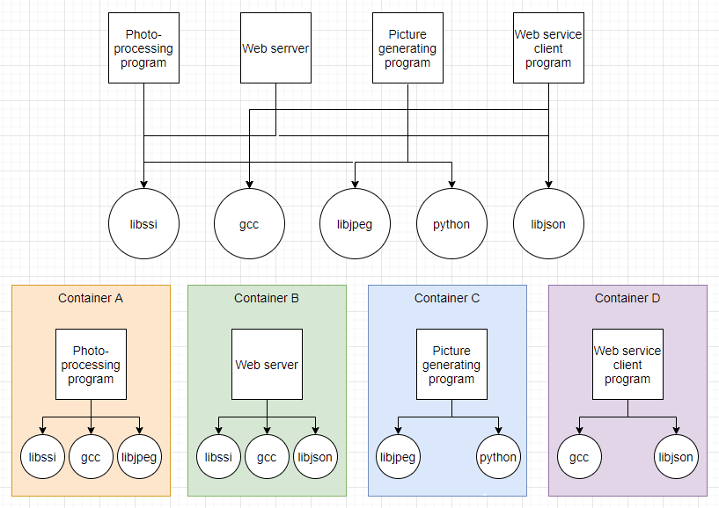
What problems does Docker solve?
Getting organized

Slide 8
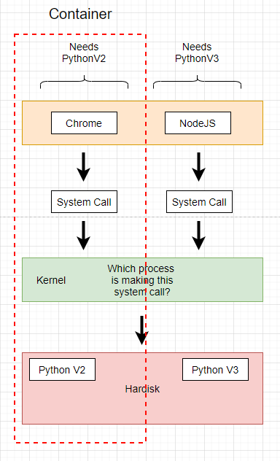
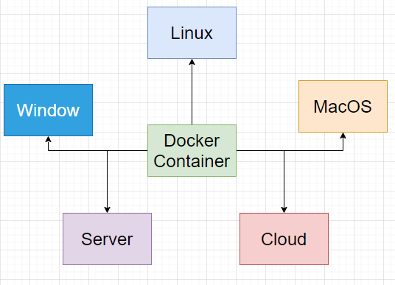
What problems does Docker solve?
Improving portability
Docker support run the same software on any system

Slide 9
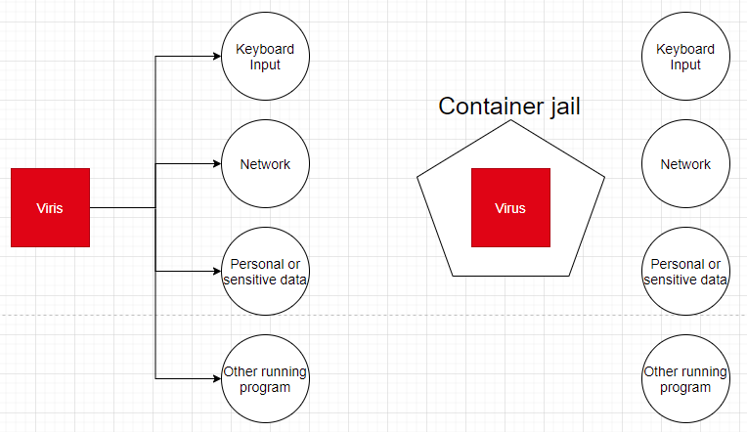
What problems does Docker solve?
Protecting your computer

Slide 10
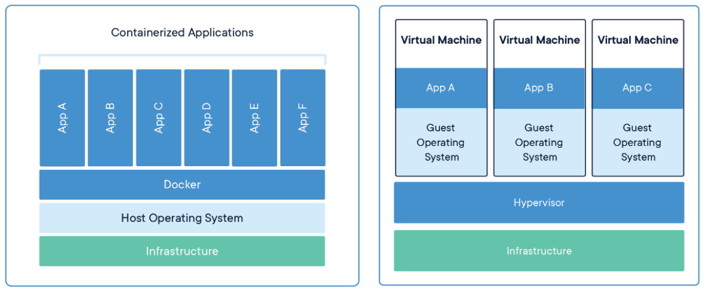
Containers vs Virtual Machines
Both of them are similar resource isolation and allocation benefits
The Container virtualizes the operating system instead of hardware. Containers are more portable, lightweight, and efficient

Slide 11
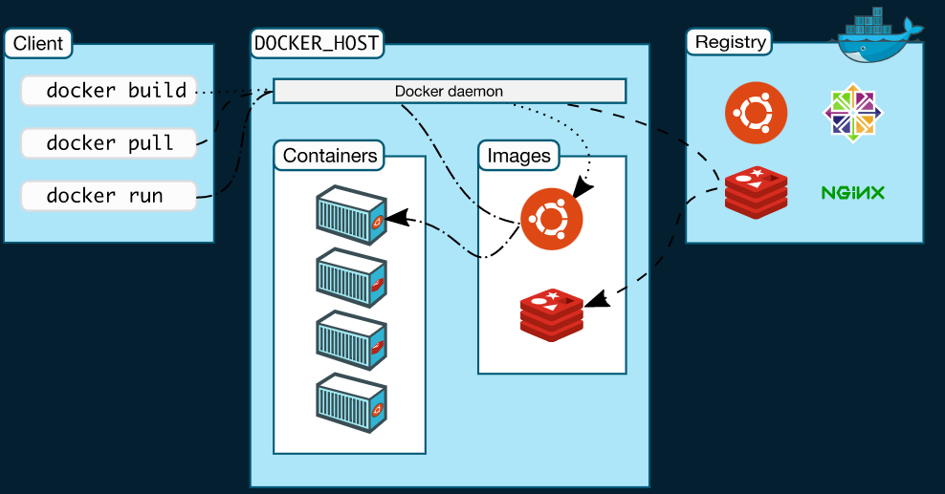
Docker Architechture
Uses a client-server architechture
Docker Client talks to Docker Daemon, which does the heavy lifting fo building, running, and distributing your docker containers.
Docker client and Deamon can run on the same system or you can connect a docker client to a remote docker deamon.
Docker client and daemon communicate using a REST API, over UNIX sockets or a network interface
Another docker client is Docker Compose, that lets you work with applications consisting of a set of containers

Slide 12
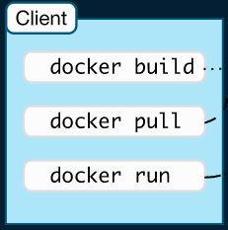
Docker Architechture - Docker client
Docker client is the primary way that many docker users interact with Docker by using a command
The docker command use the Docker API
The docker client can communicate with other than one daemon

Slide 13
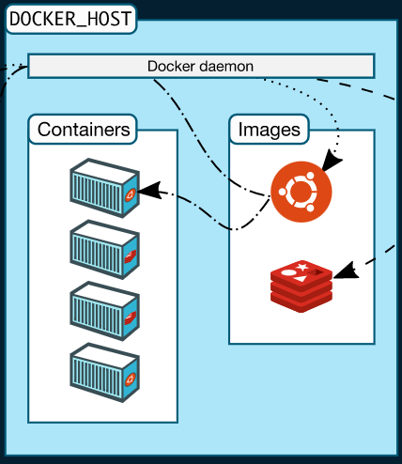
Docker Architechture - Docker daemon
Docker Daemon listens for Docker APIs requests and manages Docker objects such as images, containers, networks and volumes
A docker daemon can also communicate with other daemons to manage docker services

Slide 14
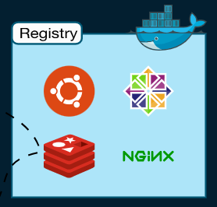
Docker Architechture - Registry
A Docker registry stores Docker Images
Docker Hub is a public registry that anyone can use
Docker is configured to look for images on Docker Hub by default

Slide 15
Docker Installation
Windows 10 Pro and some Windows 10 Home users will be able to install Docker desktop if their computer supports the Windows Subsystem for Linux (WSL2)
After completely installed WSL2, Then install Docker Desktop
If you are Windows 10, You can download Docker Toolbox

Slide 16
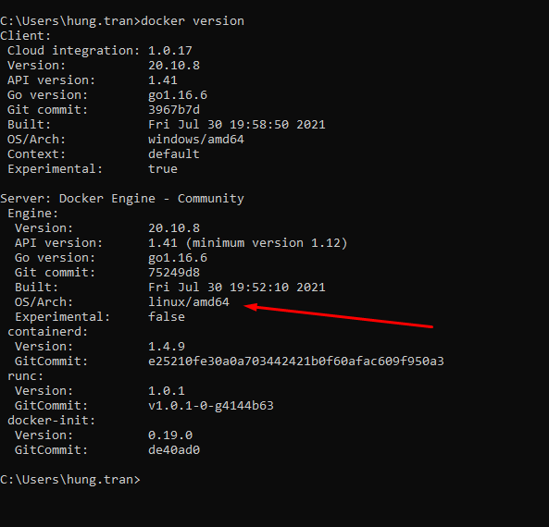
Using Docker Client - docker version
“docker version” command
Check the docker version settup on the local machine

Slide 17
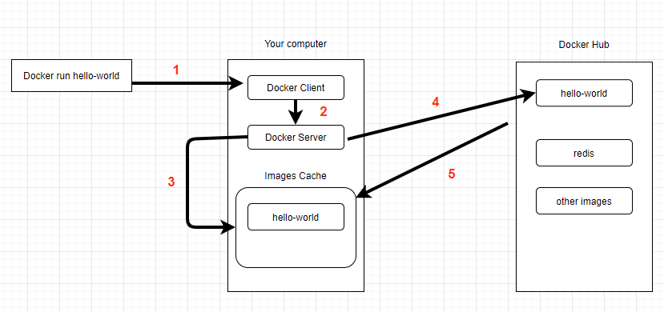
Using Docker Client - docker run hello-world
“docker version” command
Check the docker version settup on the local machine
Notes:
docker run hello-world
That mean we want to starts up a new container with the name hello-world
Docker Client communicate to Docker Server
If the Docker Server found a hello-world container from Images Cache, It will execute it.
If not, It will call to Docker Hub to find hello-world image.
If exists, that image will be downloaded to Images Cache on local machine and run it.

Slide 18
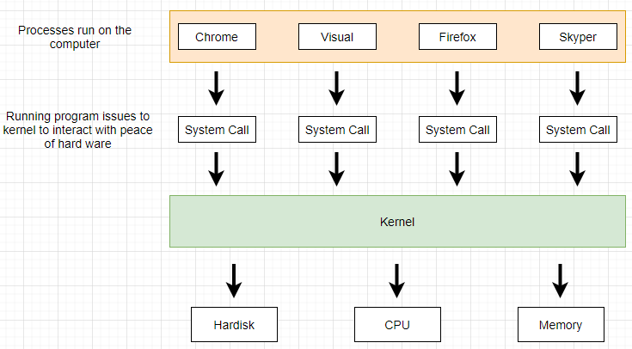
Docker containers
How operating system run in a local

Slide 19
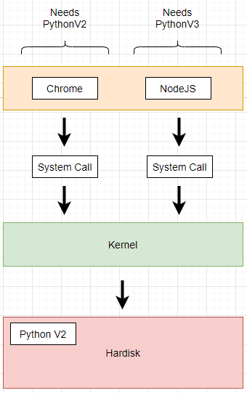
Docker containers
How operating system run in a local
The difference versions on the system

Slide 20
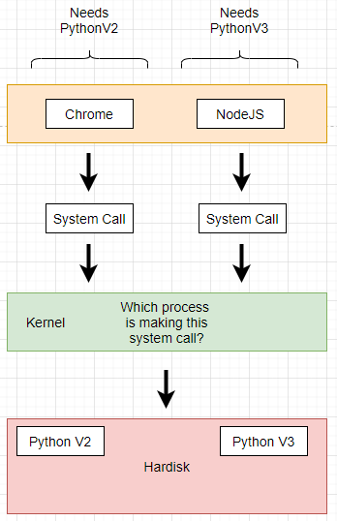
Docker containers
How operating system run in a local
The difference versions on the system
Name spacing technique

Slide 21
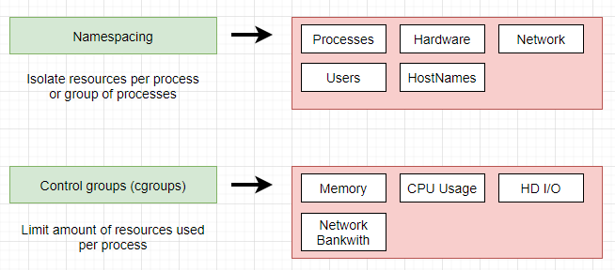
Docker containers
Name spacing technique
It’s not only use for Hardware, It can be also use for software.
Name spacing and Control groups used to isolate and single process and limit the amount of resources it can be used of.

Slide 22
Docker containers
Name spacing technique
It’s not only use for Hardware, It can be also use for software.
Name spacing and Control groups used to isolate and single process and limit the amount of resources it can be used of.

Slide 23
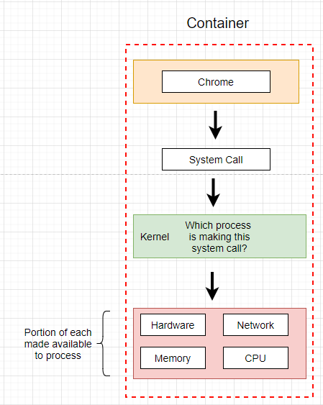
Docker containers
Name spacing technique
It’s not only use for Hardware, It can be also use for software.
Name spacing and Control groups used to isolate and single process and limit the amount of resources it can be used of.

Slide 24
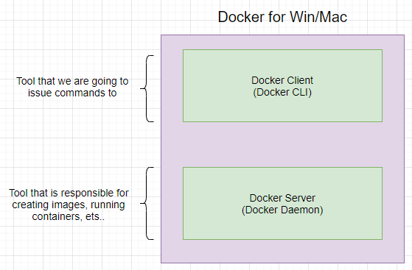
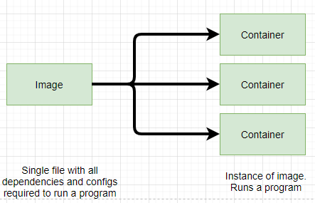
Docker containers
The relationship between image and container and how it work.

Slide 25
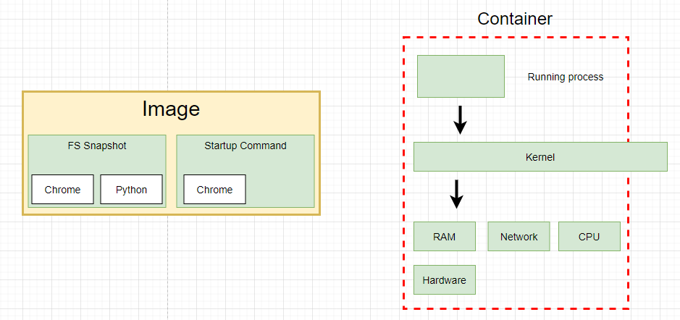
Docker containers
The relationship between image and container and how it work.

Slide 26
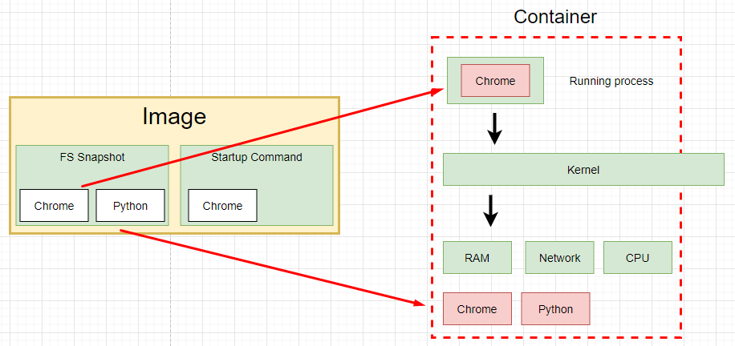
Docker containers
The relationship between image and container and how it work.

Slide 27
How’s Docker running on your computer
Name spacing and Control groups is not on Windows or Mac, It’s belong to Linux

Slide 28
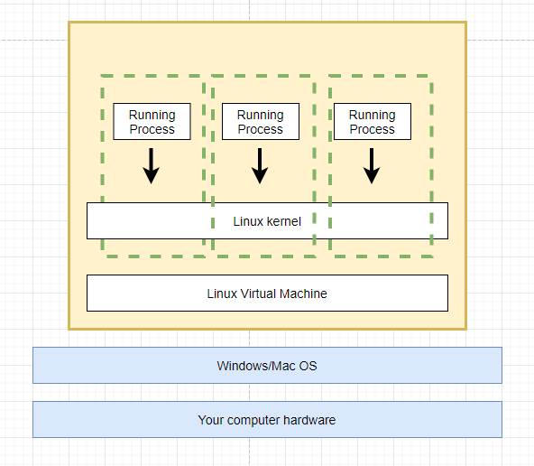
How’s Docker running on your computer
Name spacing and Control groups is not on Windows or Mac, It’s belong to Linux
Linux Virtual Machine is host the docker and container to run

Slide 29
THANKS FOR LISTENING

